Slide 1
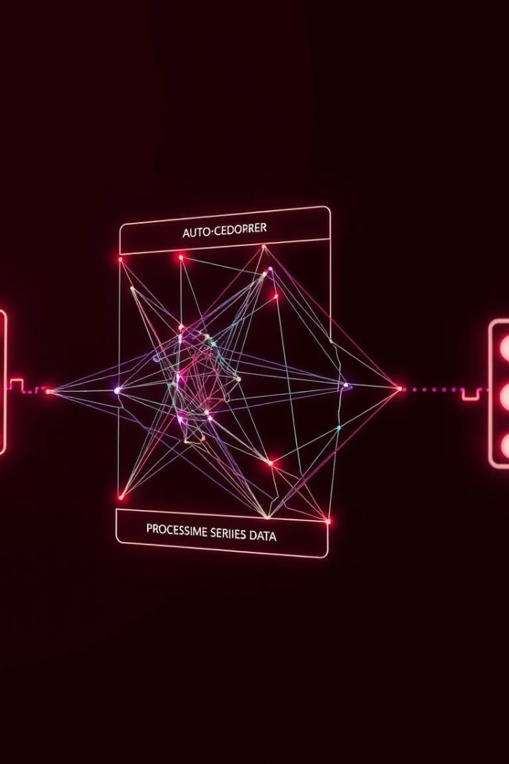
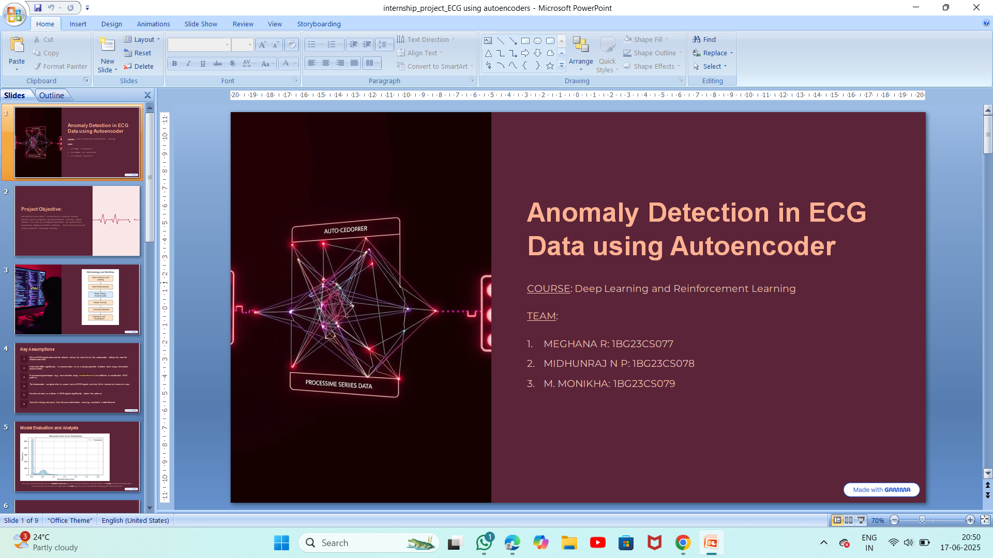
Anomaly Detection in ECG Data using Autoencoder
COURSE: Deep Learning and Reinforcement Learning
TEAM:
MEGHANA R: 1BG23CS077
MIDHUNRAJ N P: 1BG23CS078
M. MONIKHA: 1BG23CS079

Slide 2

Project Objective:
The objective of this project is to develop an AI powered anomaly detection system using deep learning techniques to identify irregular patterns in ECG data. By leveraging autoencoders the system aims to support early diagnosis of cardiac conditions , reduce false positives and improve healthcare monitoring efficiency.

Slide 3

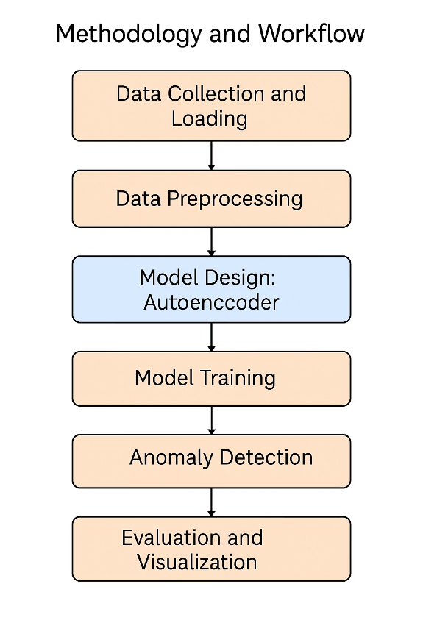

Slide 4






Key Assumptions
Normal ECG signals dominate the dataset and can be used to train the autoencoder without the need for labeled anomalies.
Anomalies differ significantly in reconstruction error, making it possible to detect them using a threshold-based method
Preprocessing techniques (e.g., normalization using StandardScaler) are sufficient to standardize ECG patterns.
The Autoencoder can generalize to unseen normal ECG signals and only fail to reconstruct abnormal ones
No external noise or artifacts in ECG signals significantly distort the patterns.
Test and training sets come from the same distribution, ensuring consistent model behavior

Slide 5
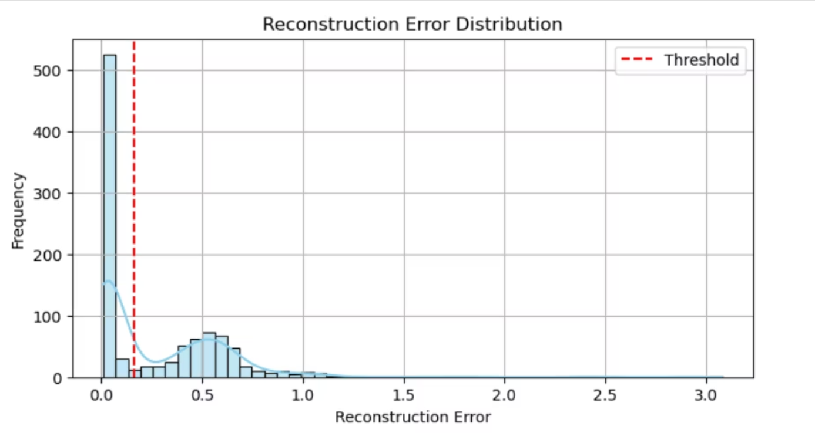
Model Evaluation and Analysis
This plot visualizes the distribution of reconstruction errors produced by the autoencoder on the test dataset. The X-axis represents the magnitude of reconstruction error for each ECG signal, and the Y-axis shows the number of instances (frequency) with that specific error.

Slide 6
Project Summary and Outcomes
This project aimed to detect anomalies in ECG signals using an unsupervised deep learning approach. An autoencoder model was trained exclusively on normal ECG patterns to learn typical signal behavior. The model then evaluated new signals based on their reconstruction error, flagging those with high error as anomalies.
Key Outcomes:
Successfully implemented and trained an autoencoder on the ECG5000 dataset.
Achieved high accuracy in distinguishing normal and abnormal ECG signals.
Developed a threshold-based classification strategy using reconstruction error.
Visualized results using reconstruction error plots, confusion matrix, and classification metrics.
Saved the trained model and scaler for future deployment in a web-based diagnostic interface

Slide 7

Future Improvements and Extensions
Incorporate Labeled Anomalies
Fine-tune the model using semi-supervised or supervised approaches for better classification of specific arrhythmias.
Use Advanced Models
Replace the basic autoencoder with Variational Autoencoders (VAEs) or LSTM-based Autoencoders to better capture temporal ECG patterns.
Real-Time Monitoring System
Deploy the model into a live dashboard using Streamlit or Flask to continuously monitor patient ECG data.
Mobile/IoT Integration
Integrate with wearable ECG devices or Raspberry Pi-based systems for portable anomaly detection.
Dataset Expansion
Train and validate the model on larger, diverse datasets (e.g., MIT-BIH Arrhythmia Dataset) for improved generalization.

Slide 8
Reflections and Learning Outcomes
Deepened Understanding of AutoencodersGained hands-on experience in implementing unsupervised deep learning models for anomaly detection using real-world biomedical data.
Insight into ECG Signal BehaviorUnderstood the structure and patterns of ECG waveforms, and how deviations can indicate medical anomalies.
Improved Data Preprocessing SkillsLearned the importance of normalization, reshaping, and cleaning time-series data for model training.
Model Evaluation ExpertiseApplied metrics like reconstruction error, confusion matrix, precision, recall, and accuracy to analyze model performance.
Experience with Deployment ToolsExplored how to integrate models into interactive web apps using tools like Streamlit, preparing for real-world applications.
Critical Thinking and Problem SolvingOvercame challenges in threshold selection, model tuning, and understanding false positives in a medical context.

Slide 9
THANK YOU

